Slide 1
Natural Language to Code Generation
Arthur Chien, Gilbert Wu, Yaxuan Mao

Slide 2
Model Utilized
In-Context Learning
Leveraging powerful, small coding models:
Qwen2.5-Coder-3B-Instruct
Deepseek-Coder-1.3B-Instruct
Supervised Fine-Tuning (SFT)
Instruction Tuning with LoRA
Qwen2.5-Coder-3B (Base)
Deepseek-Coder-1.3B (Base)

Slide 3
CodeAlpaca-20k Dataset
~20,000 instruction–response pairs (18k train / 2k test).
Create a function in Java that takes an integer as an argument and returns the factorial of that integer.
public static int factorial(int n) {
if (n == 0) {
return 1;
} else {
return n * factorial(n - 1);
}
}
Covers Python, JavaScript, Java, C++.
Includes code generation, debugging, refactoring.

Slide 4
Evaluation
Metrics: Pass@1
Measures functional correctness of the generated code with tests
Benchmarks
HumanEval
HumanEval+
Instruct HumanEval
MultiPL-E
Python
Cross Language
(C++, Java, JavaScript, …)

Slide 5
ICL Approach
Baseline
0-shot
1-shot
3-shot
5-shot
PREFIX_0_SHOT =
'''
You are an expert Python programmer.
Given a problem description, write a correct Python function that satisfies the requirements.
Return only executable Python code and nothing else.
'''
PREFIX_1_SHOT = """
Here are some examples:
### Example 1
def factorial(n):
if n == 0 or n == 1: return 1
return n * factorial(n - 1)
"""
Notes:
So for our ICL setup, we tried five different prompt styles — baseline, 0-shot, 1-shot, 3-shot, and 5-shot. We first ran all of them on the first 100 problems of MBPP to see which one actually works best.

Slide 6
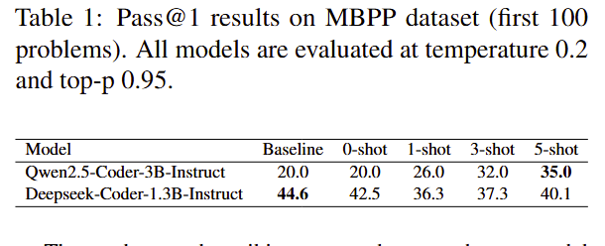
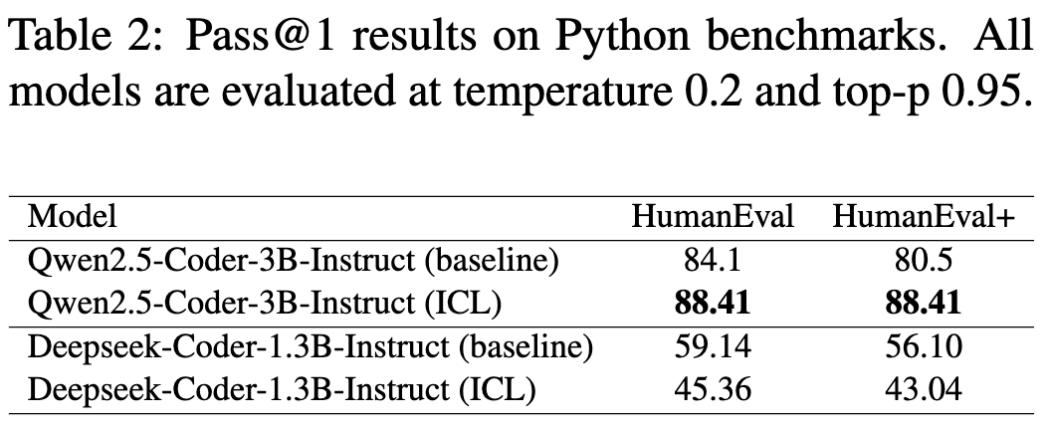
ICL Result
For Deepseek Coder Instruct, we found that baseline performs better than the few-shots prompts.
As a small model, the model tends to treat the prefix as noise?
Notes:
Surprisingly, for Deepseek-Coder-1.3B, the simple baseline prompt beat every few-shot version by a pretty large margin. So we took that baseline and tested it again on HumanEval and HumanEval+, and the pattern stayed the same — baseline consistently outperformed all the ICL prompts.
Our takeaway is that for small models, long prefixes look more like noise than helpful examples. So keeping the prompt short actually gives us the best performance.

Slide 7
ICL Result
Qwen Coder Instruct benefits significantly from few-shot examples.
The performance increases with the number of shots, indicating effective pattern learning from examples.
Notes:
In our prompt selection experiment, the 5-shot configuration achieved 35% accuracy, representing a 75% relative improvement over the baseline. And The performance increases monoton-
ically with the number of shots, indicating effective pattern learning from examples. The ICL evaluation results for the model on human eval achieves 88.41% pass@1 with 5-shot ICL configuration.

Slide 8
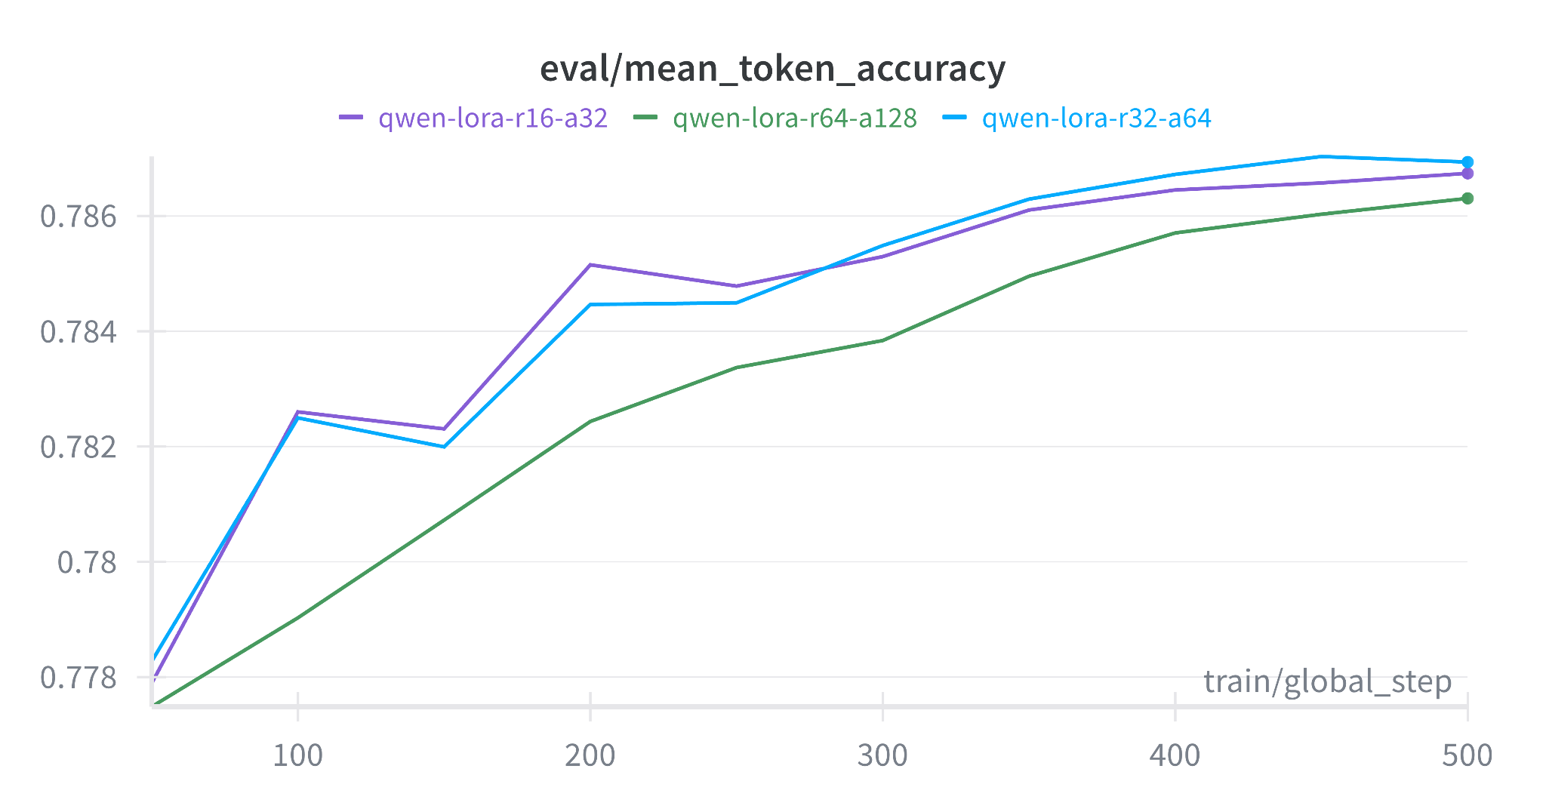
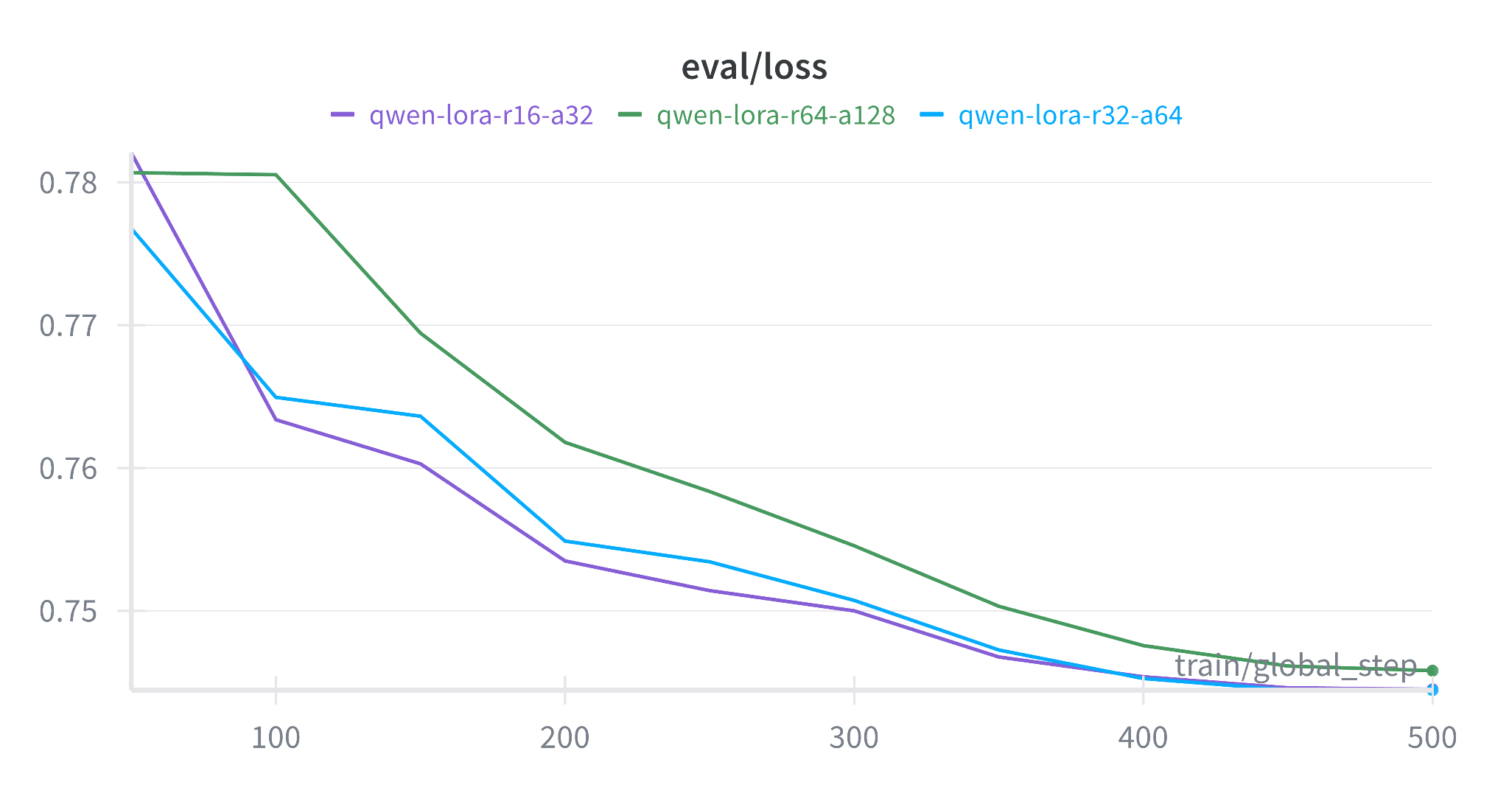
SFT - Hyperparameter Sweep

Slide 9
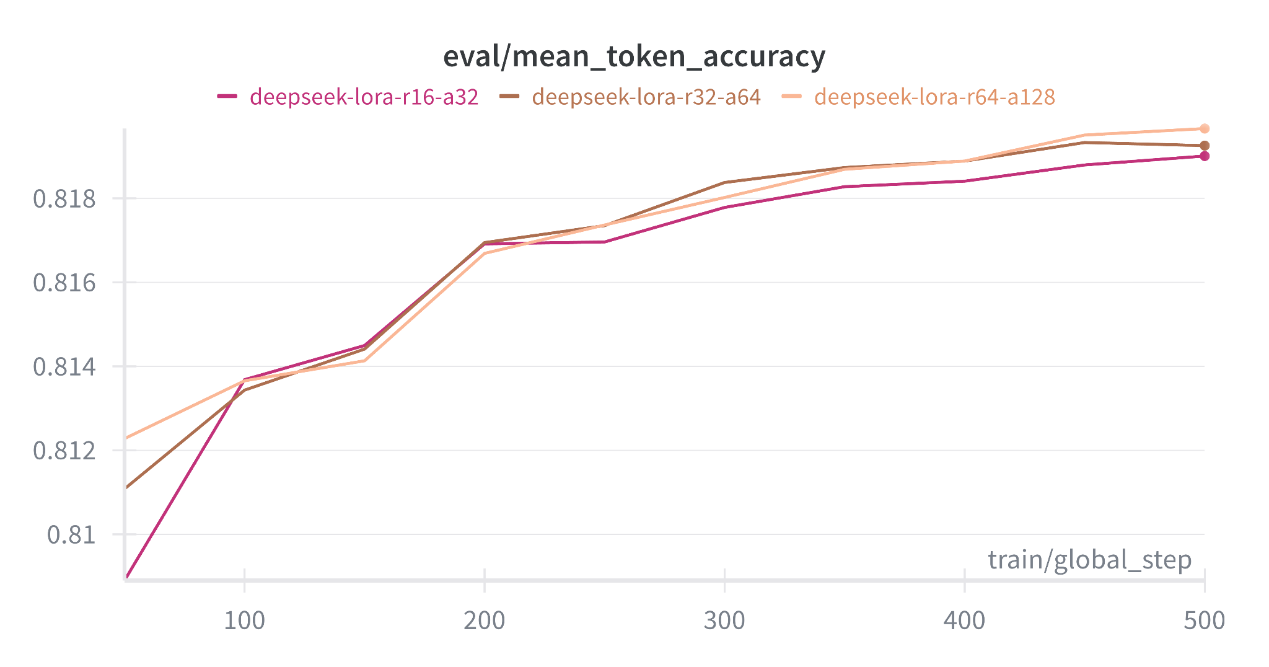
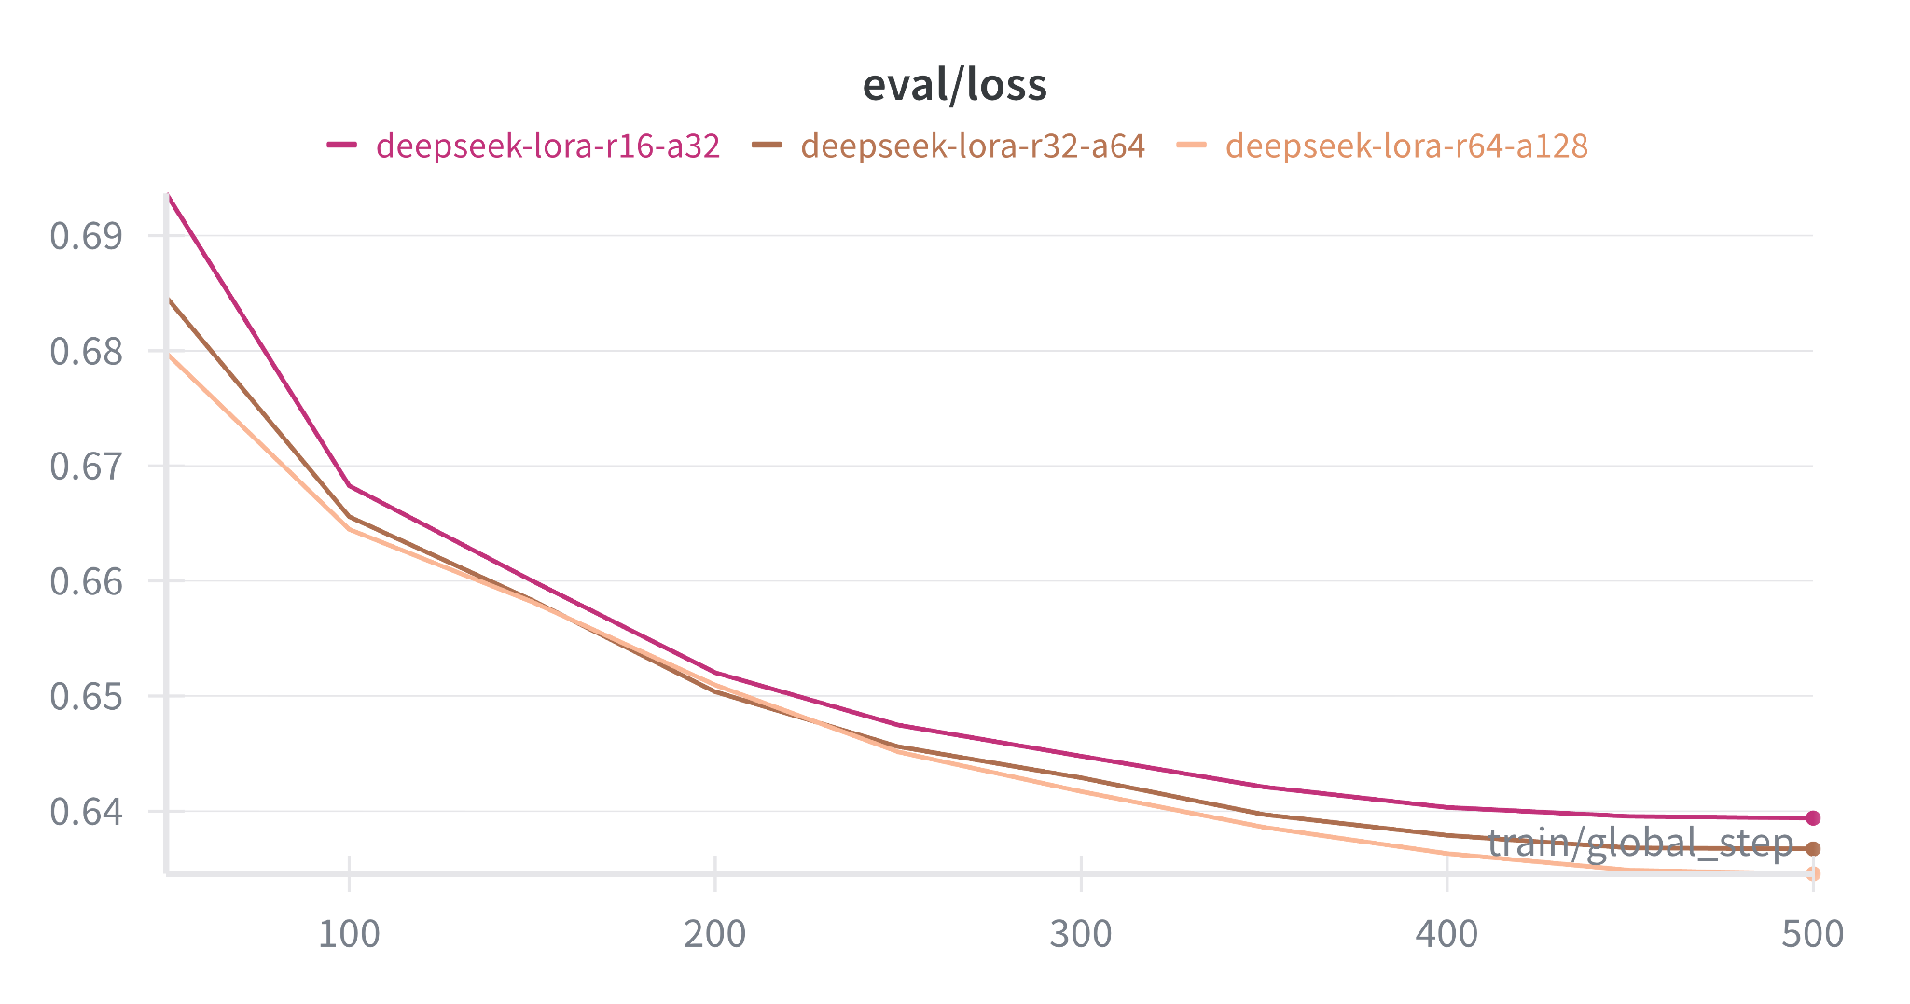
SFT - Hyperparameter Sweep

Slide 10
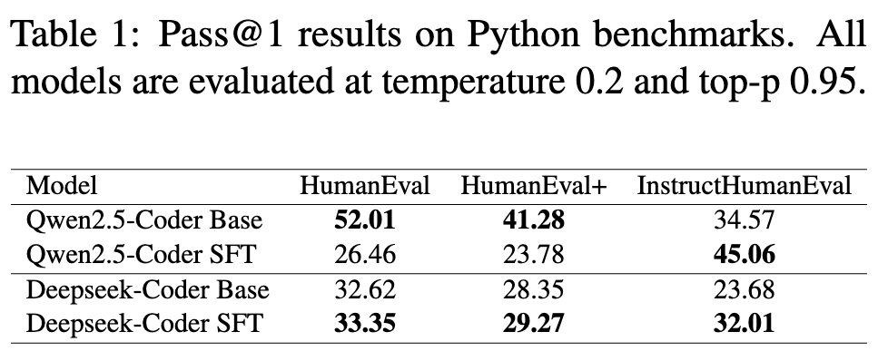
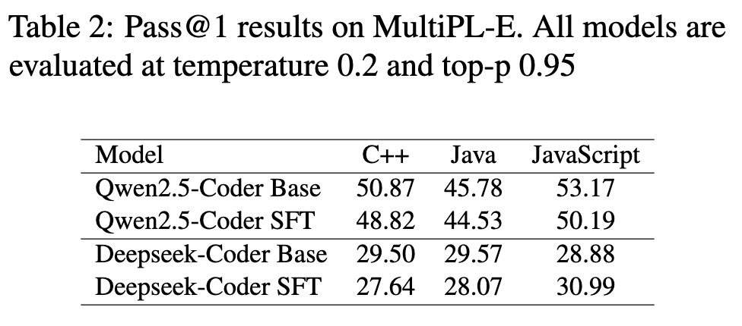
SFT Results
Both model shows improvement on InstructHumanEval, indicating successful adaptation to instruction-following formats.

Slide 11
SFT Results
For Deepseek, SFT improves performance across all Python benchmarks but Qwen exhibits severe performance degradation after fine-tuning…

Slide 12
SFT Results
Maybe Qwen specialized too heavily on the instruction-response format of the training data ?

Slide 13
Thank You For Your Attention!

